Slide 1
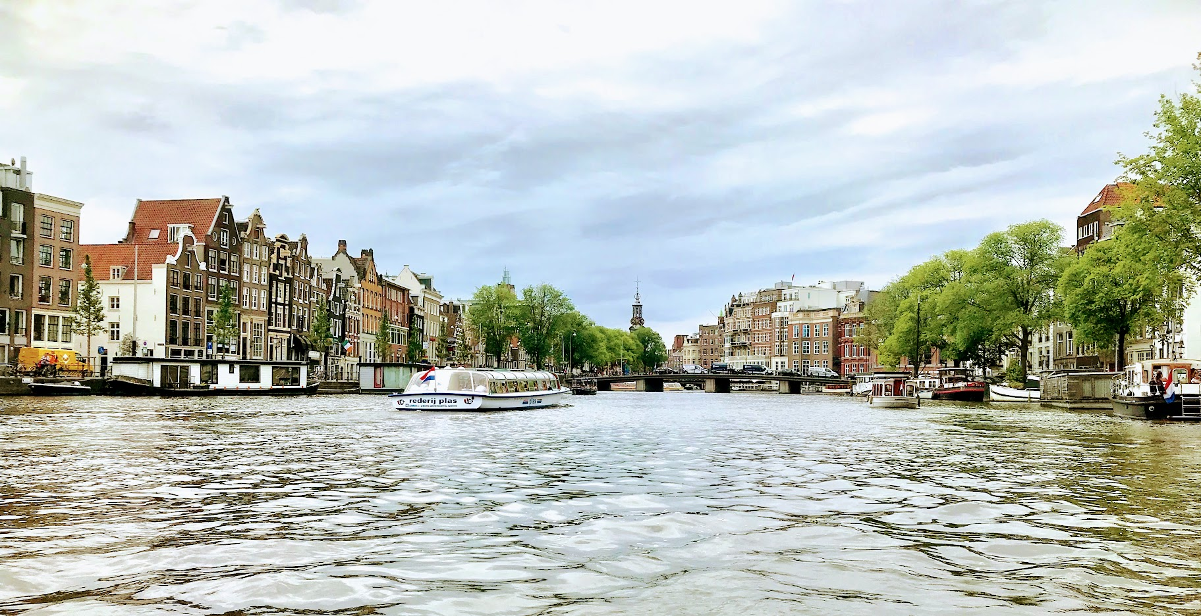
Why Travel?
Fun
New Experiences
Personal Growth
Improve Language or Cultural Knowledge
It’s good for your ~ mind, body, spirit
Meet New People
Share something special with someone special

Slide 2
Where should I go?
Dream Vacation?
No Ideas?
“Must see” in every country
Less Popular Destination
Consider second or even third cities
~ Less expensive
~ Less crowded
~ Just as beautiful
~ Less touristic/more authentic

Slide 3
Where should I stay?
Hostels are the most economical choice!!
What is a hostel?
Budget accommodation:
€ 10- 50 per person per night
Many different kinds ranging from cheap to luxury:
bunk room with shared bath
Common space including a kitchen for your use
Could be specific to your activity such as backpacking, biking, etc.

Slide 4
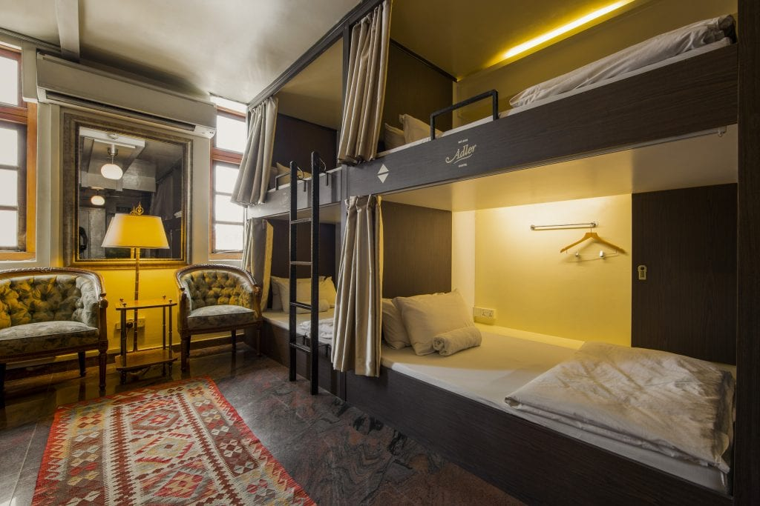
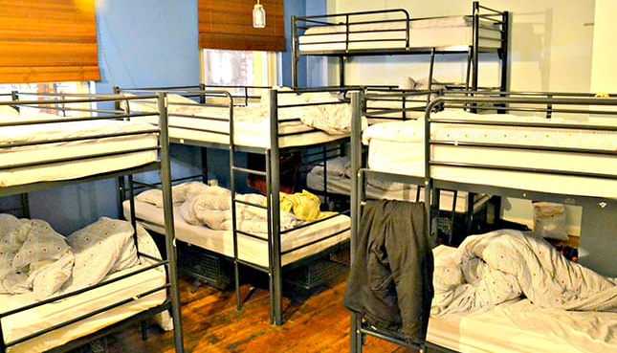
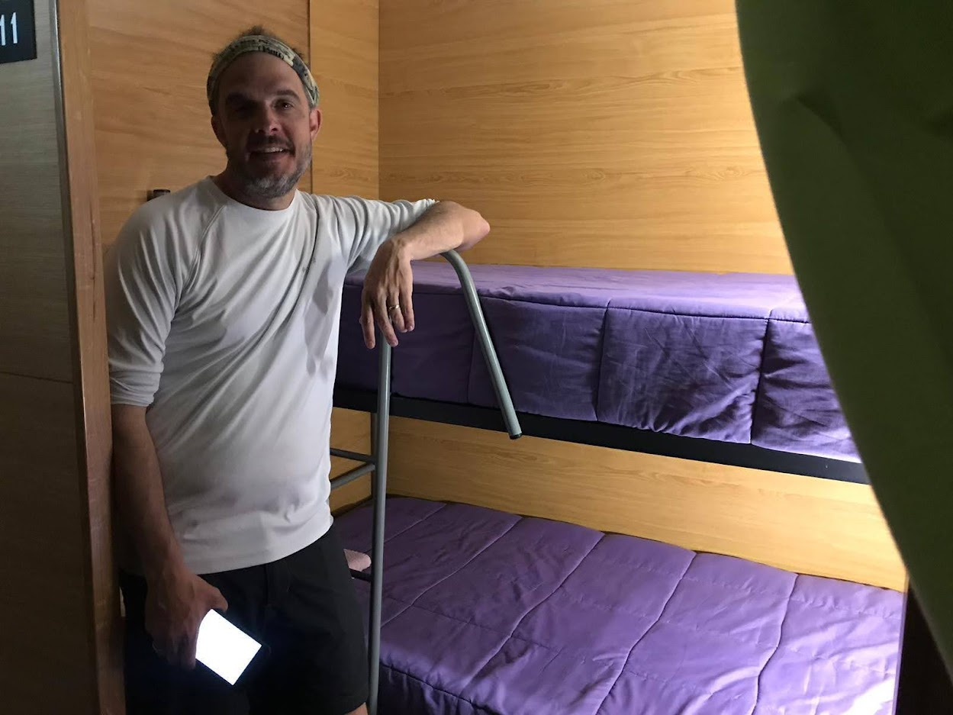

Slide 5
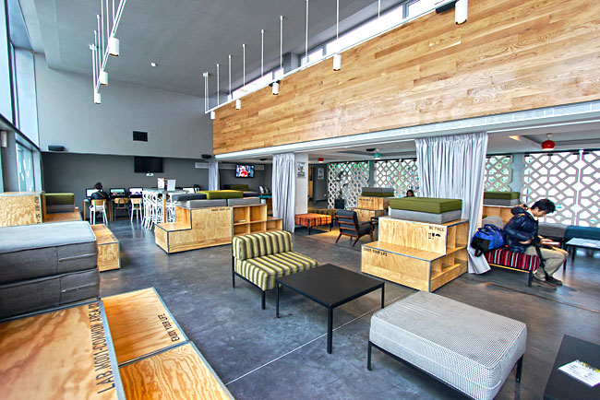
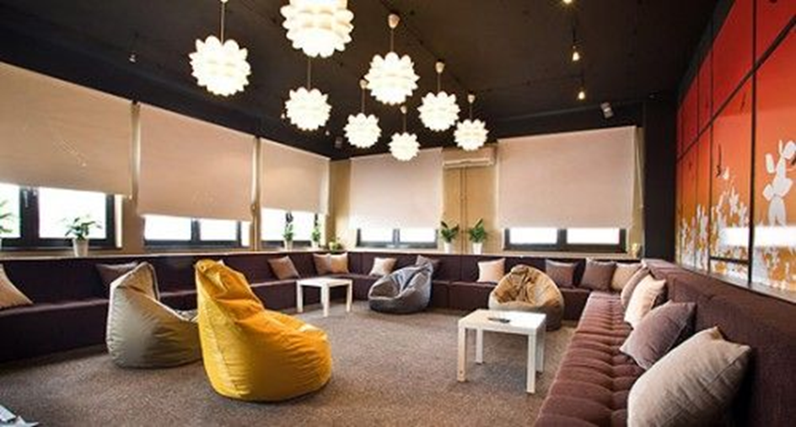
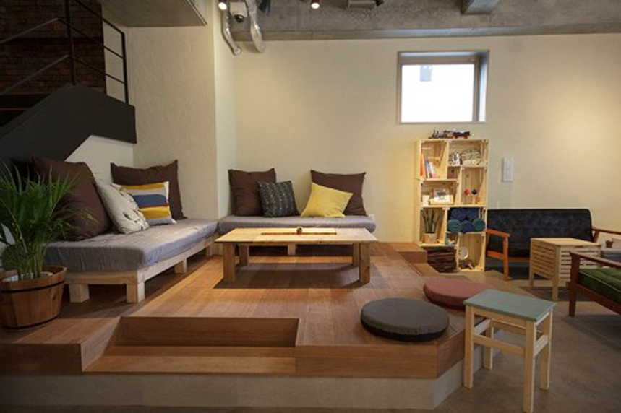
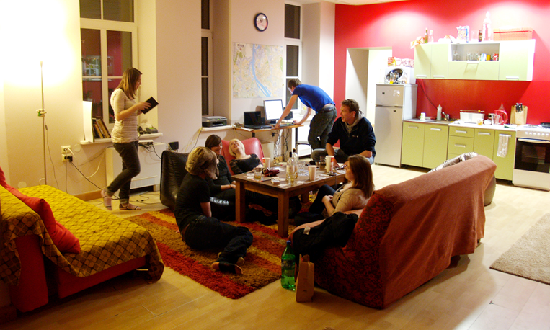
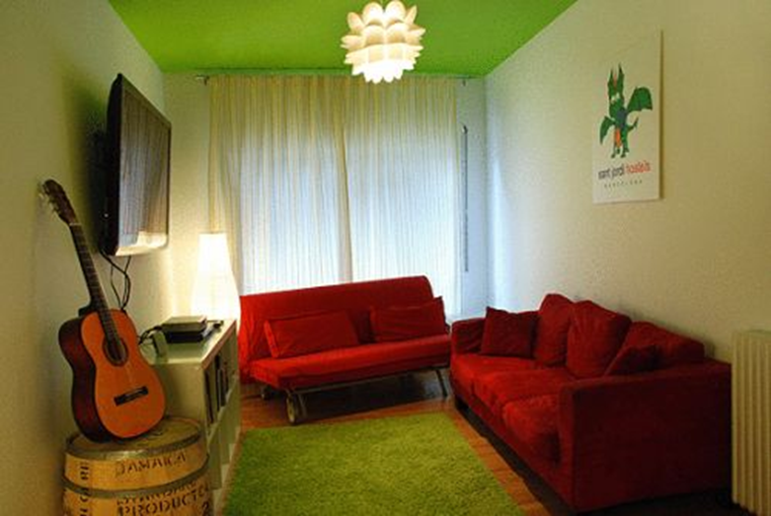

Slide 6
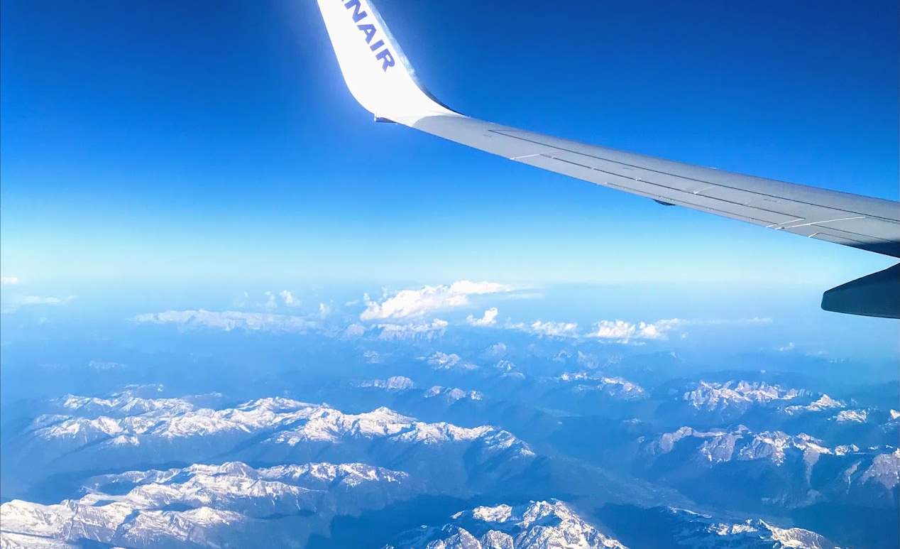
How do I get there?
Find the cheapest ticket to the continent
Get a hopper flight to your desired city
European Economy airlines include:
-Ryan Air
-Veuling
-EasyJet

Slide 7
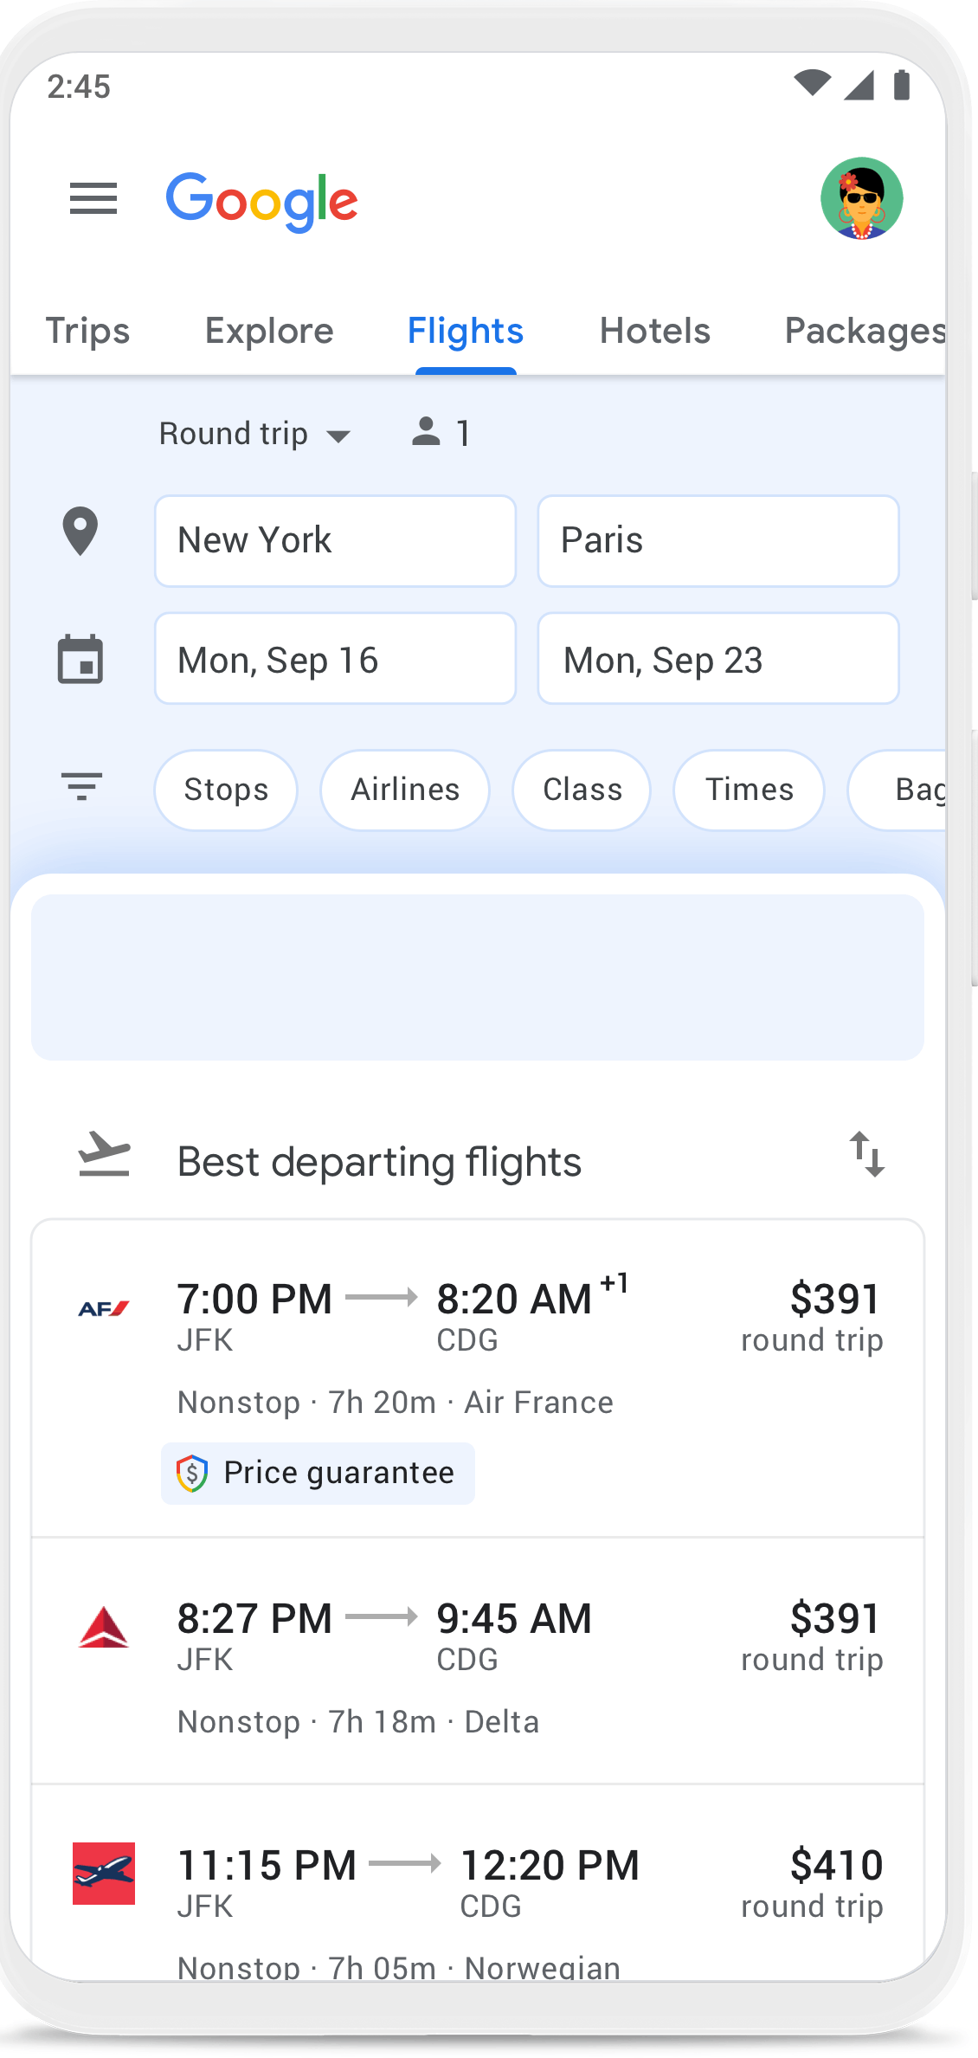
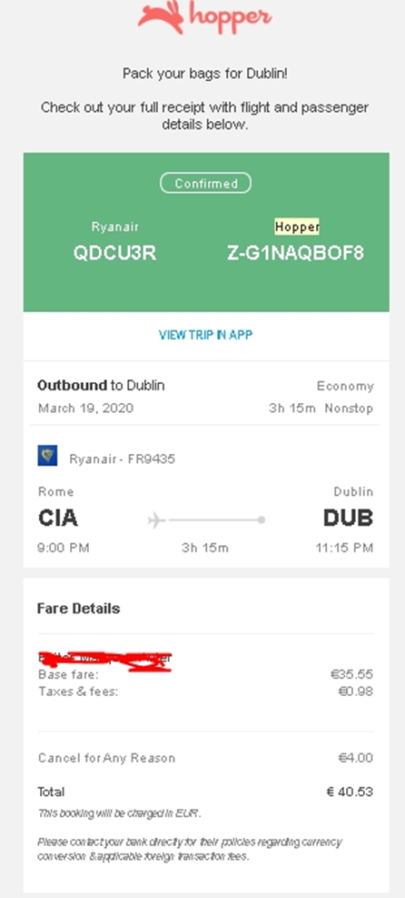
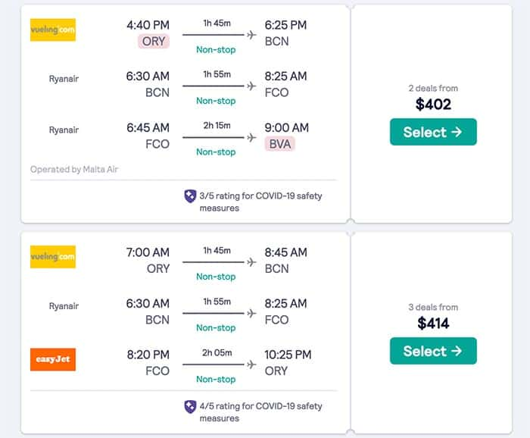
Cheap flight Search Engines
Advantages:
Multi City Flights
Set Alerts
https://www.skyscanner.com/flights
https://www.google.com/travel/flights
https://faredrop.com/

Slide 8
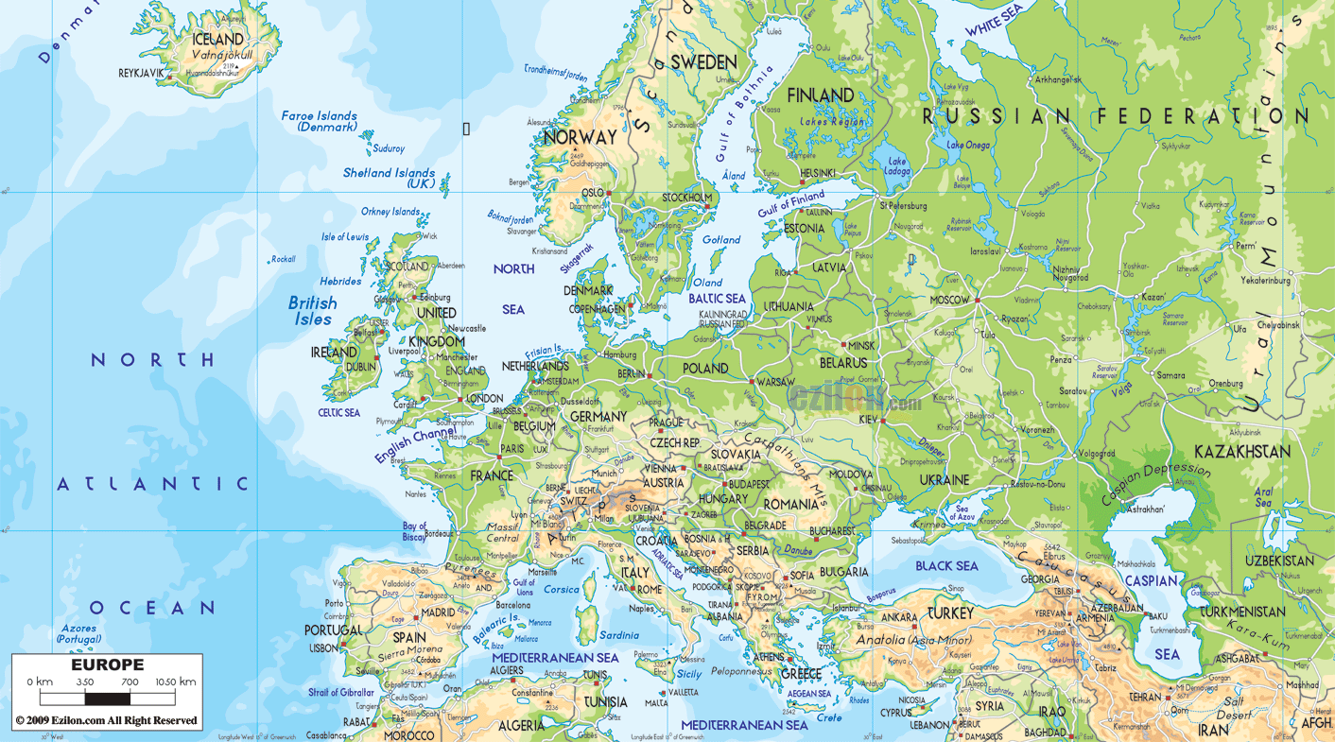

Slide 9
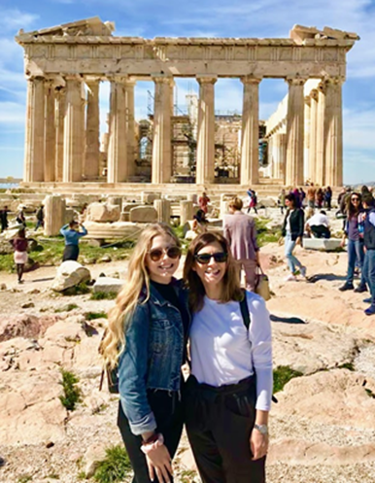
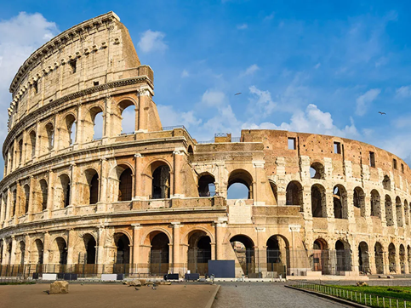
What do I do when I get there?
Every country has its must see places
They are iconic for a reason
They will be expensive
Get in early/Get out late
(one night)
Remember why you’re there
Find free tours
Look for student discounts

Slide 10
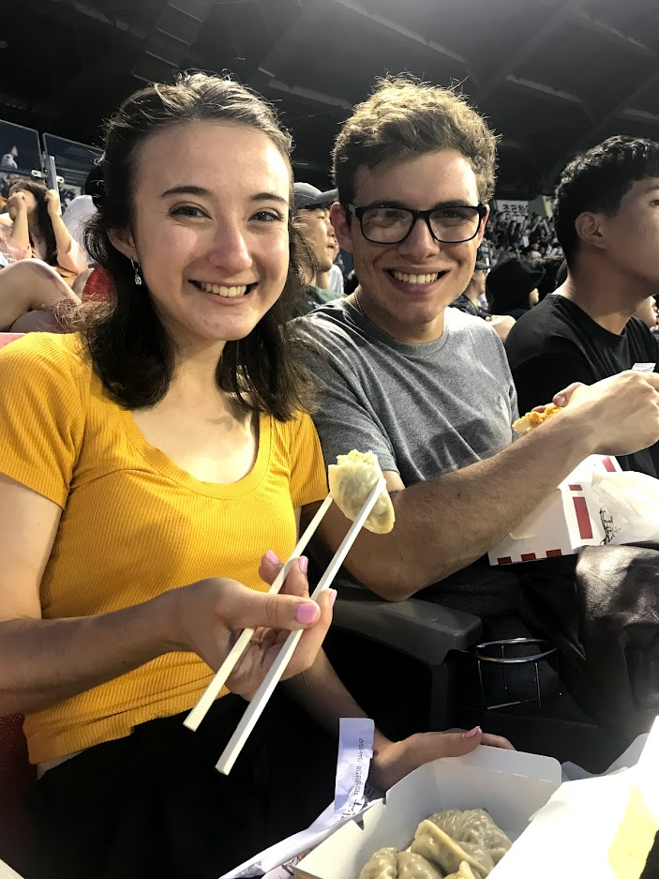
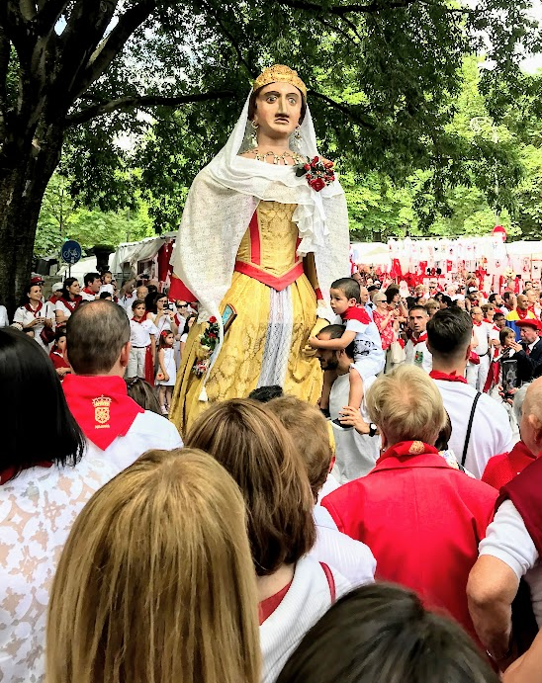
Must See or Off the Beaten Path There are a lot of ways to see the see the world on a budget
Share in a local sporting experience
Look for local festivals
Buy groceries, cook in hostel, picnic
Look for museums free
days

Slide 11
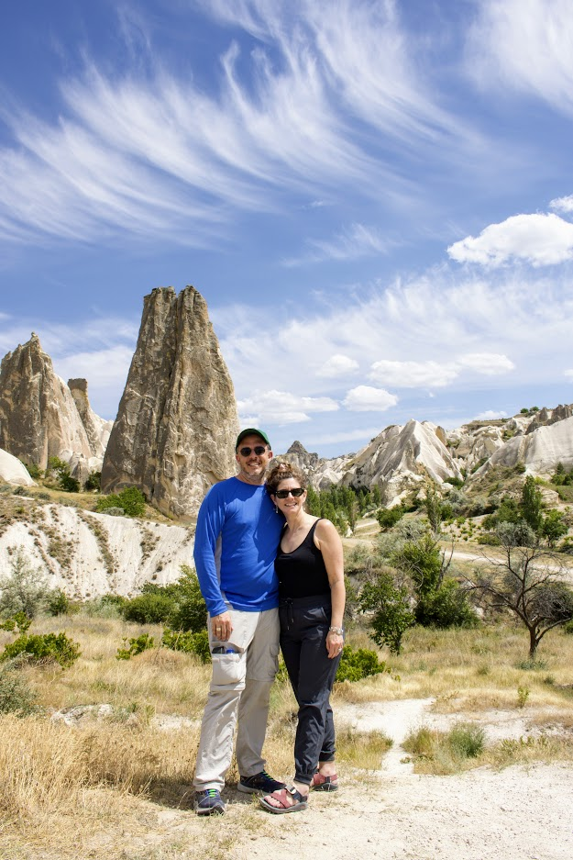
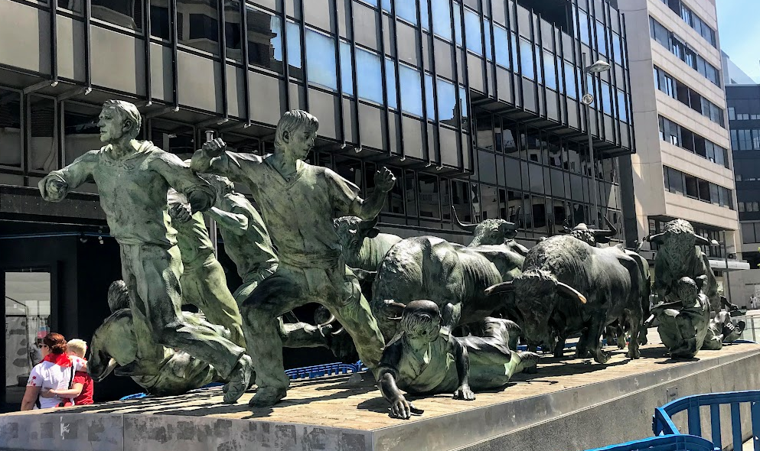
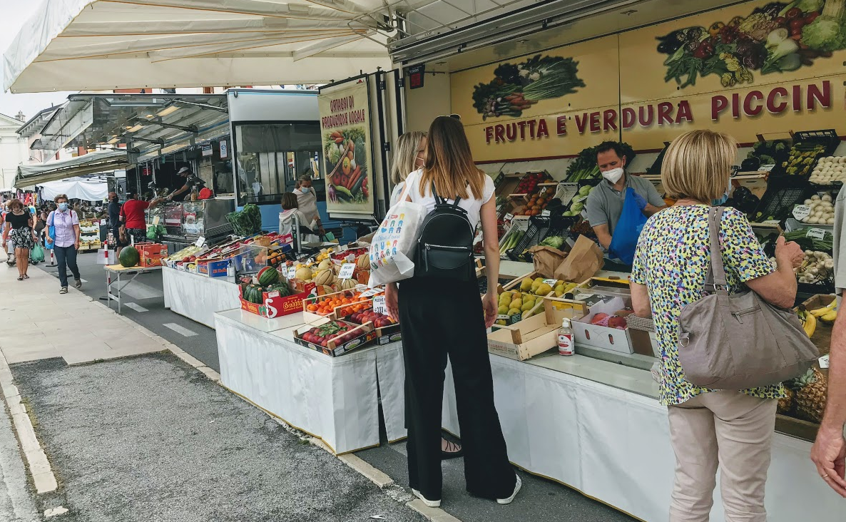
There are a lot of ways to see the see the world on a budget
Street musicians and entertainers
Public art
Take a scenic hike
Public Gardens
Google best sunset location
and bring a picnic
Local Markets
River walks in most major cities

Slide 12
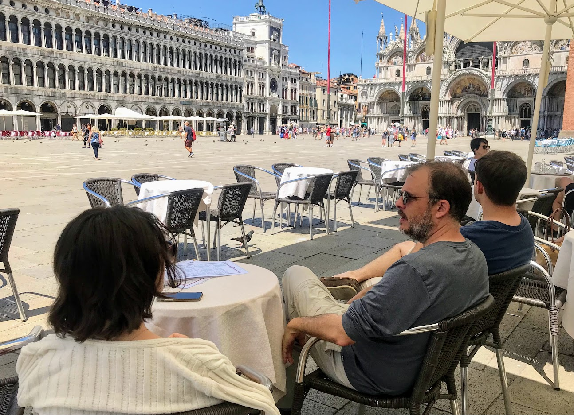
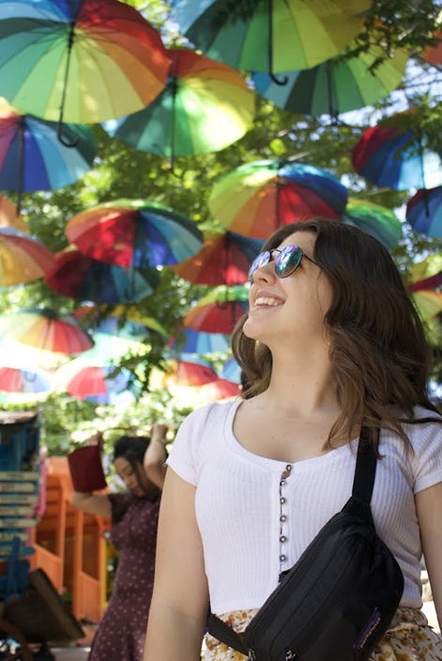
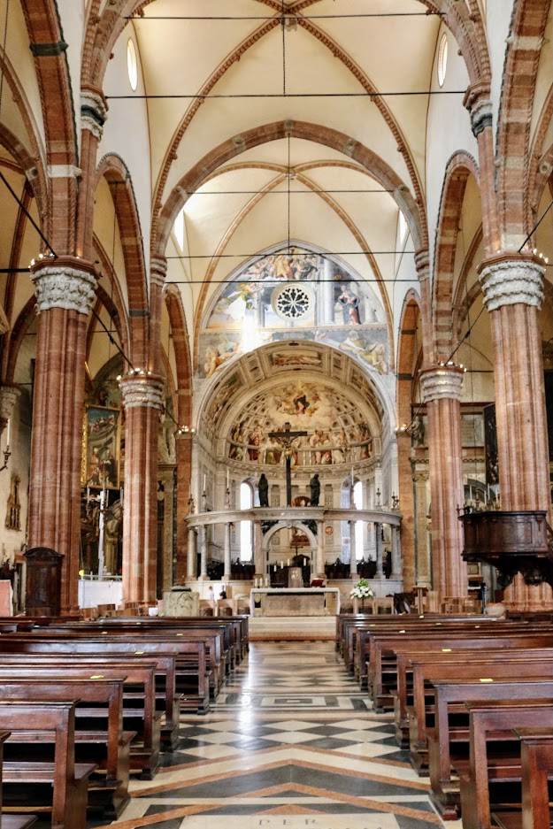
There are a lot of ways to see the see the world on a budget
Travel during the “Off Season”
Be flexible on dates
Offer to get “Bumped”
Many Churches, Mosques, Synagogues and Temples are free and they’re gorgeous
Find the perfect photo location
Get lost
People watch in outdoor cafe
Remember second and third cities

Slide 13
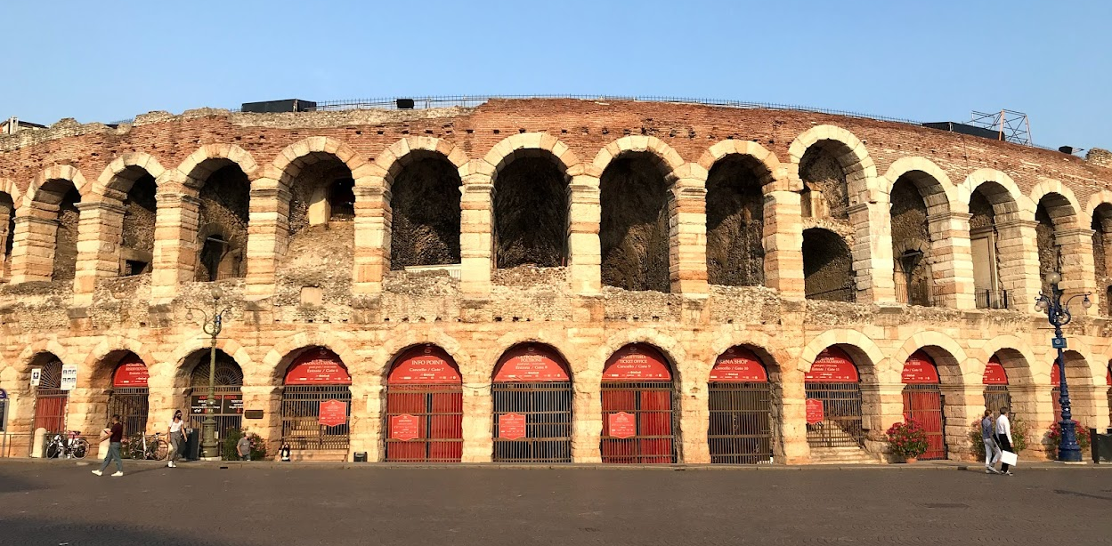
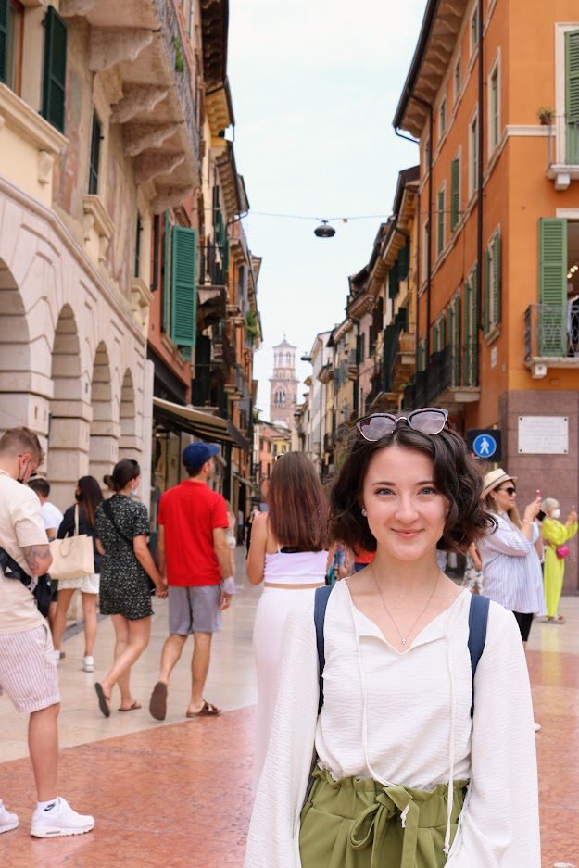
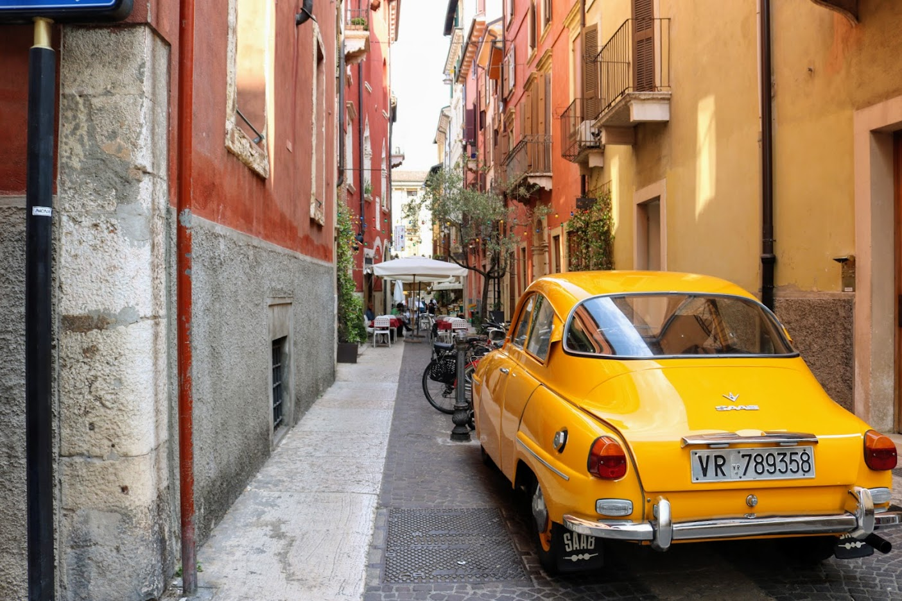
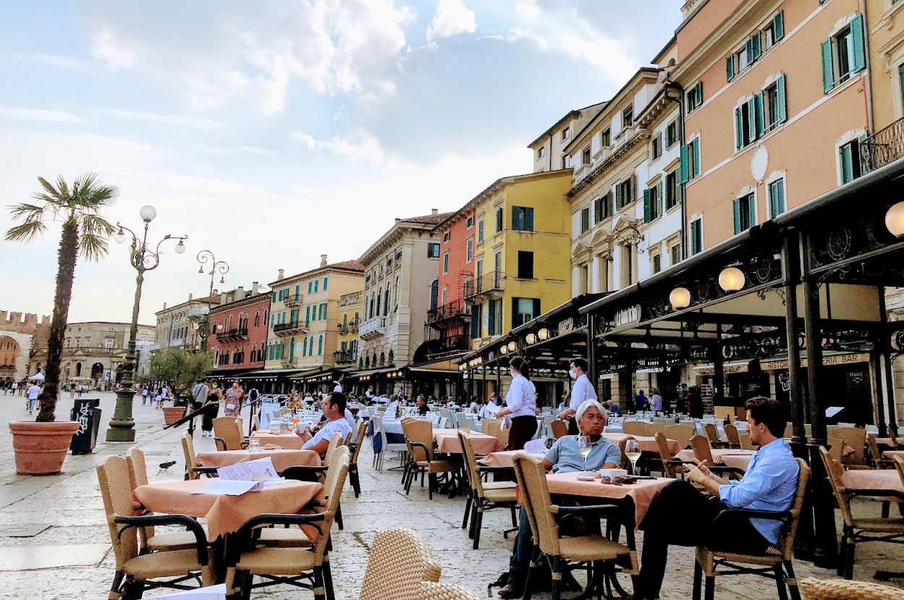
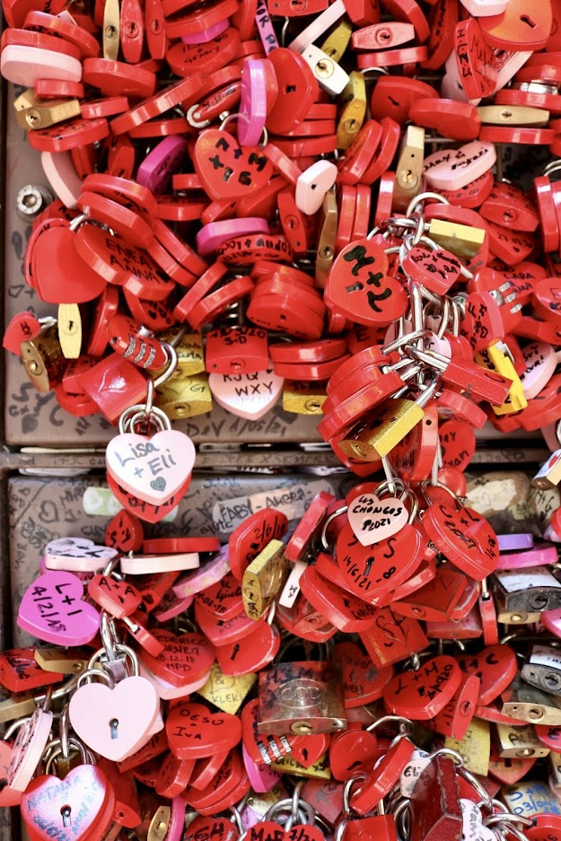
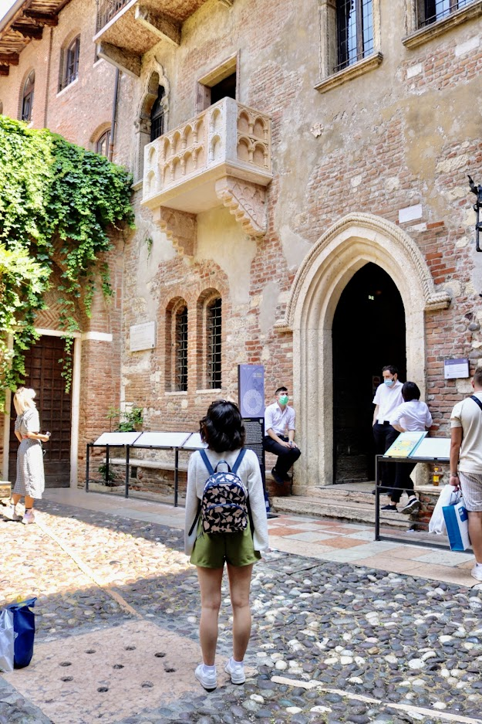
Verona, Italy a Second city

Slide 14
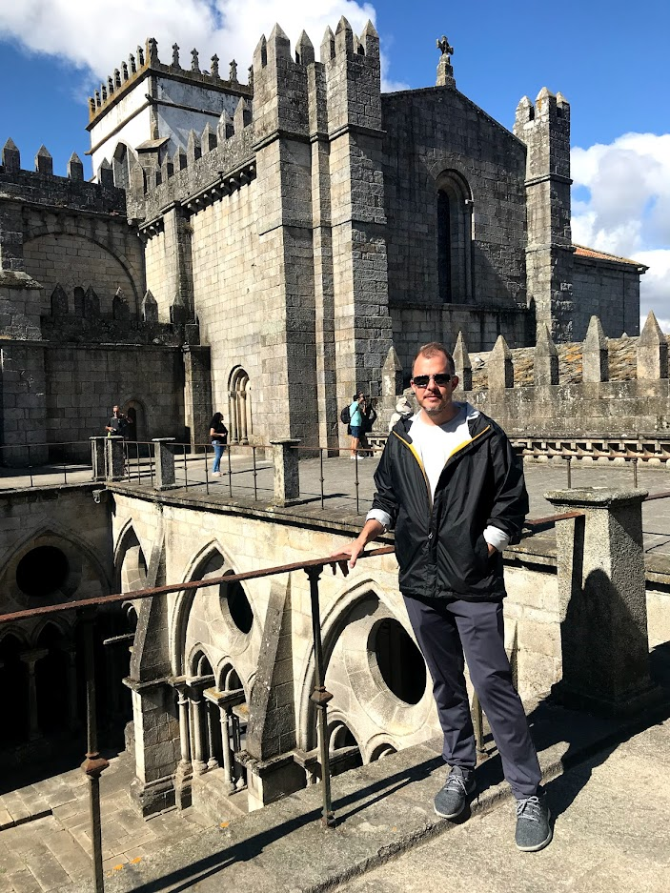
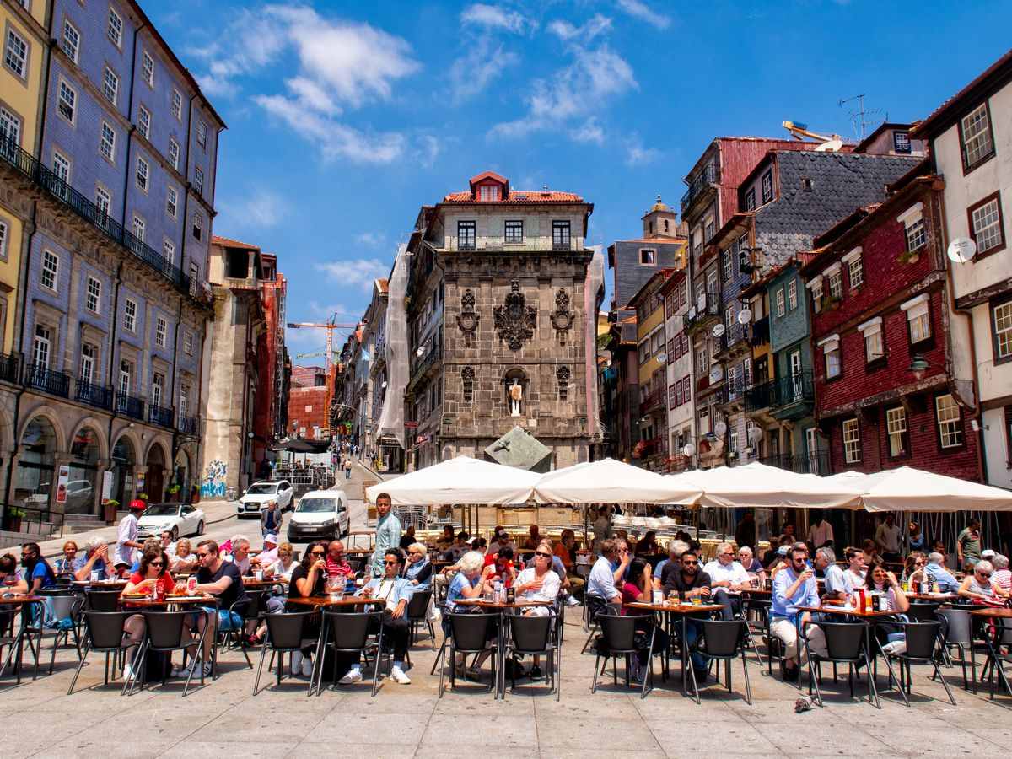
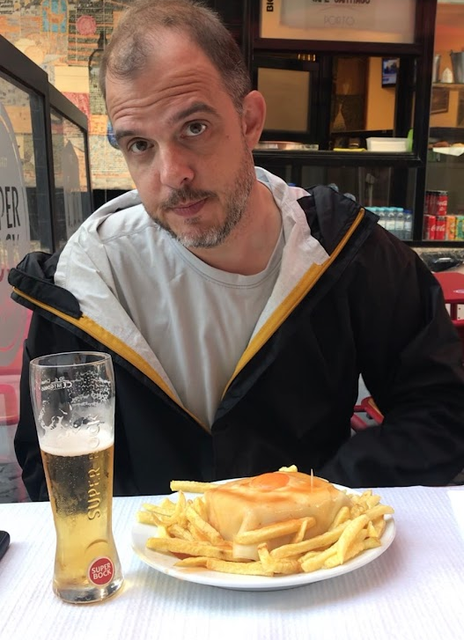
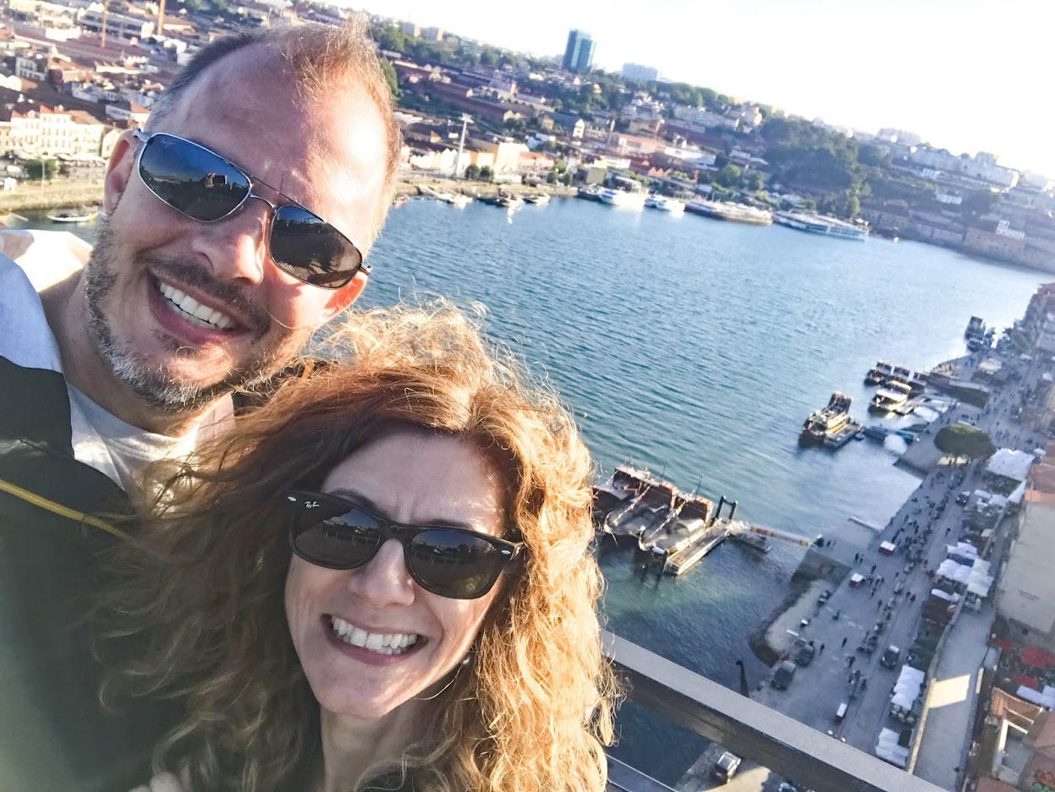
Porto, Portugal ~ a Second city

Slide 15
But What Will I Eat ?!

Slide 16
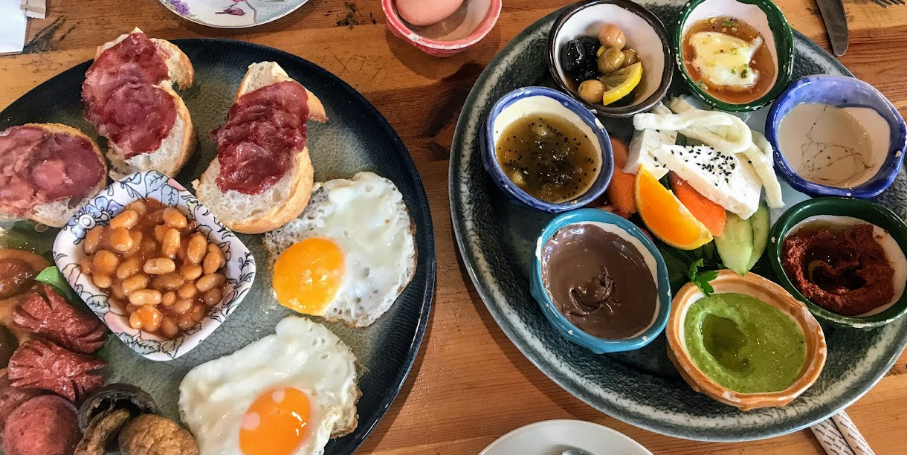
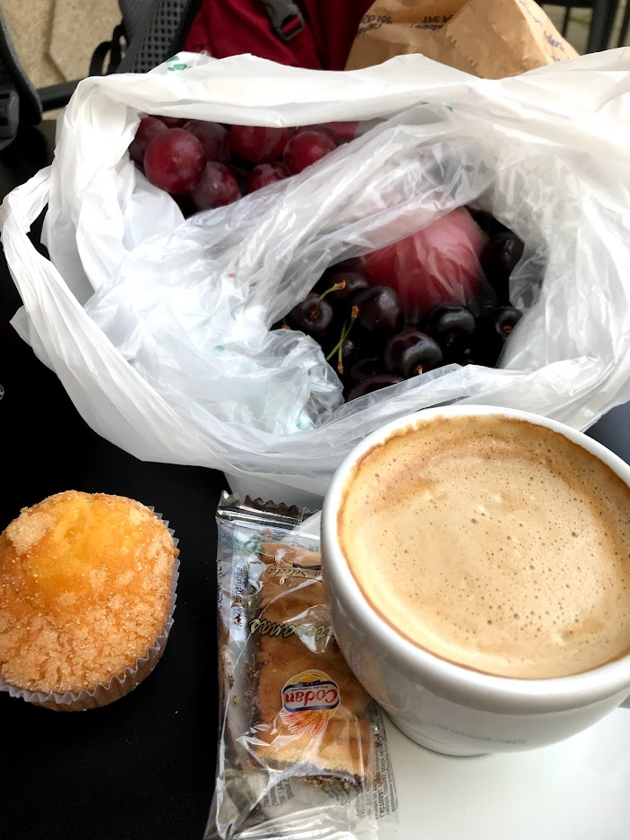
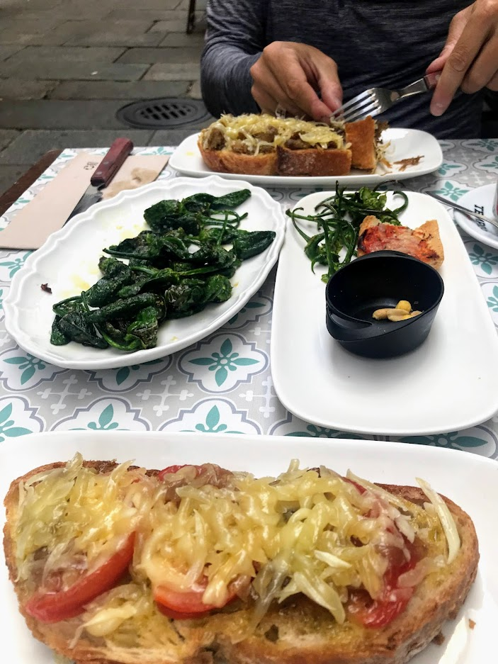
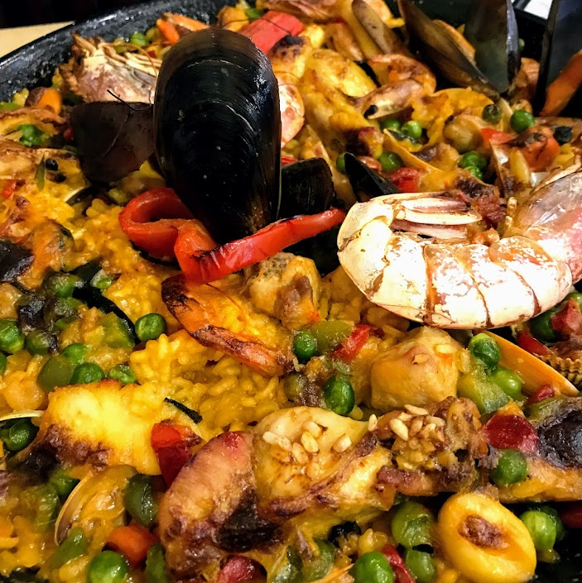
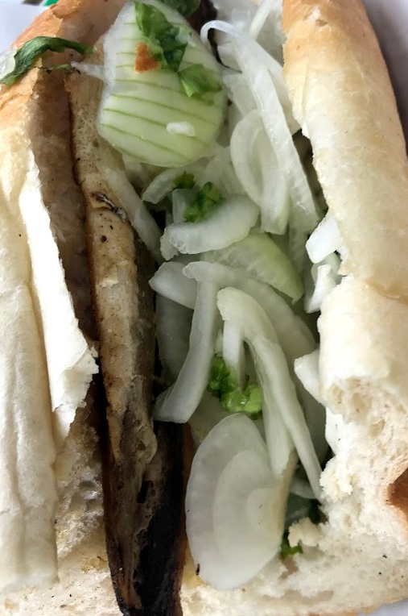
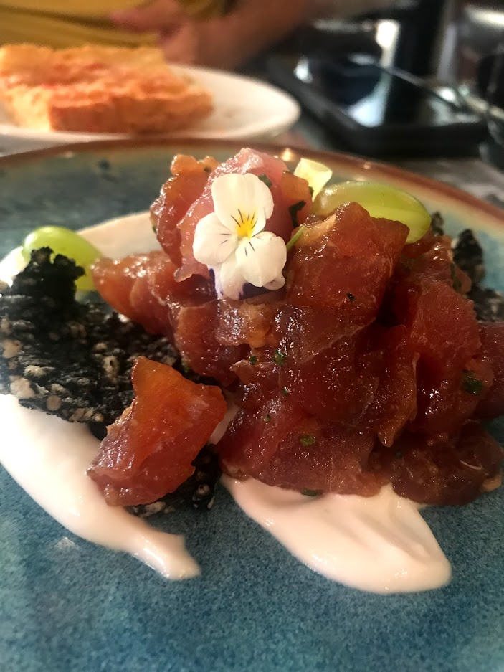
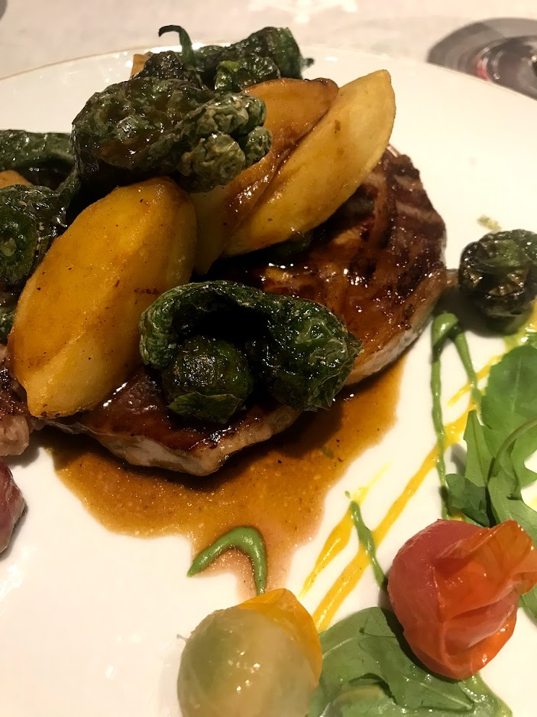
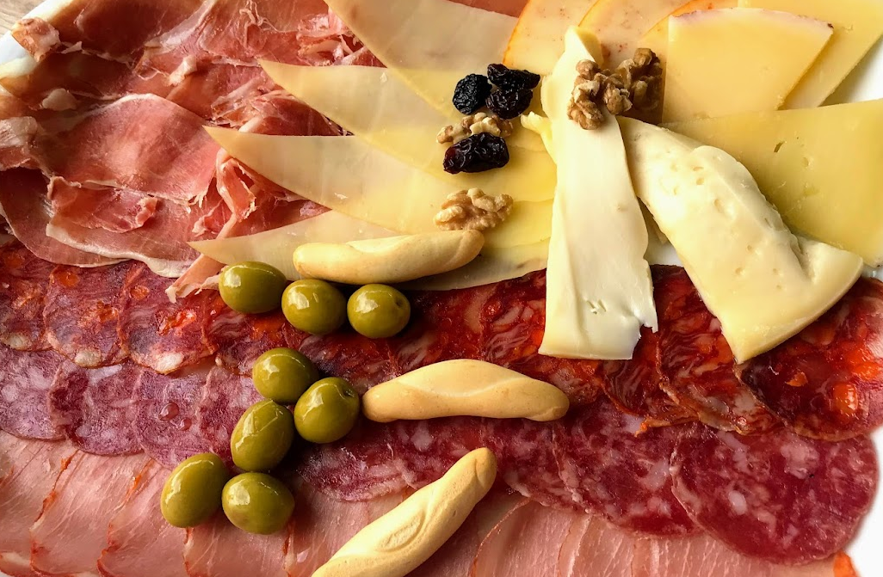
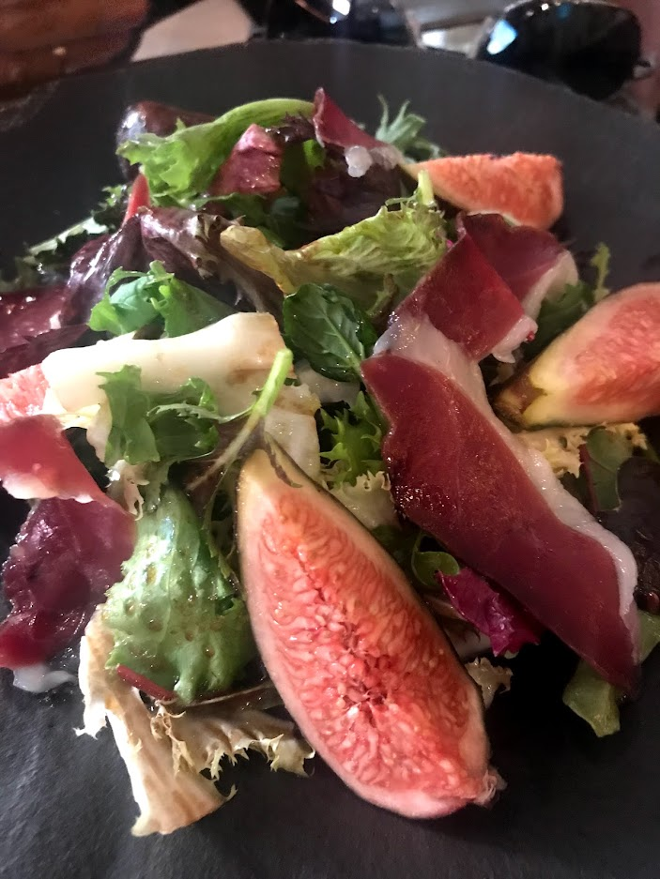
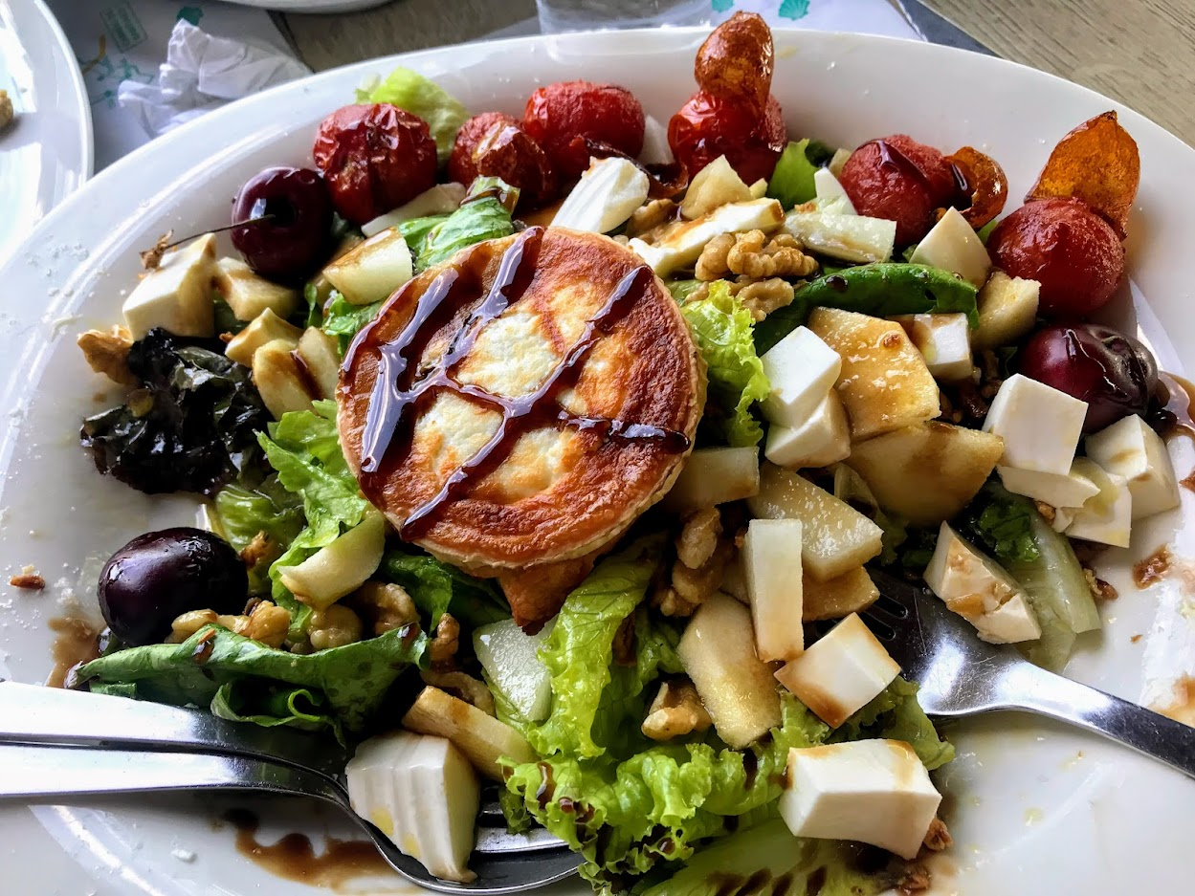
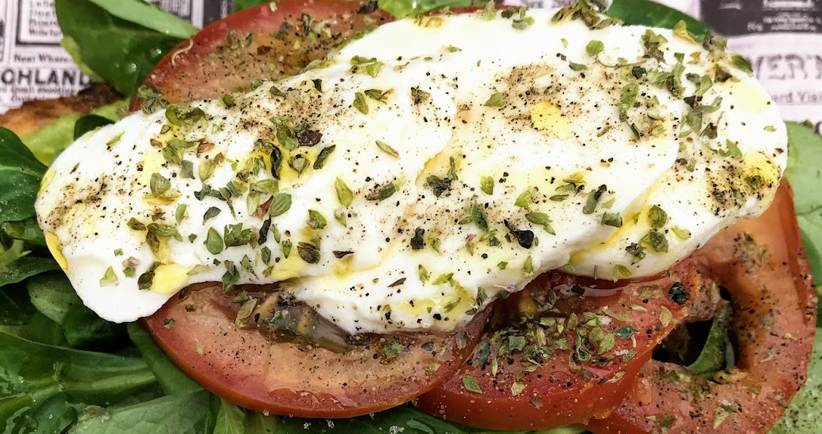
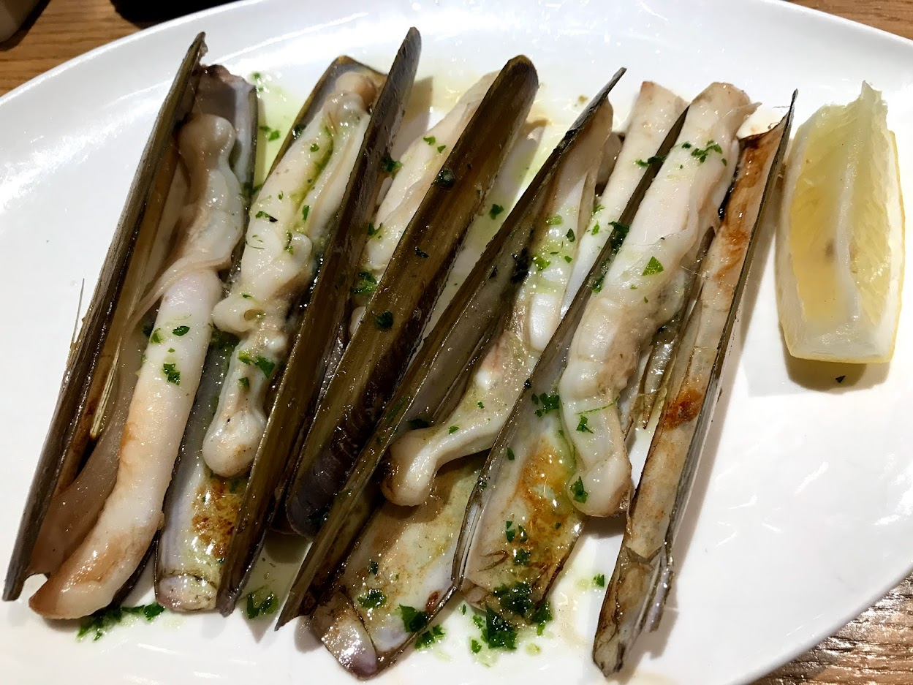

Slide 17
Planning Tips
Find Sample itineraries and other ideas on Pinterest
Watch YouTube videos of places your interested in visiting
Follow travel sites of cities and countries you’d like to see

Slide 18
Safety Matters
https://youtu.be/ig4I96hqE4o

Slide 19
It’s Your Turn
Choose a destination
https://www.ricksteves.com/
Find a Flight (or flights)
Skyscanner.com
Find a place or places to stay
hostelworld.com
Plan a couple things to do

